Slide 1


Amazon Sales analysis
Helly Modi

Slide 2


Agenda
Introduction
Dashboard
Key Sales Insights
Strategic Improvements
Conclusion

Slide 3

Introduction
Sales management has gained importance to meet increasing competition and the need for improved methods of distribution to reduce cost and to increase profits.
Sales management today is the most important function in a commercial and business enterprise.
This analysis provides a deep dive into Amazon's sales performance, highlighting key revenue trends, top products, and regional insights.

Slide 4
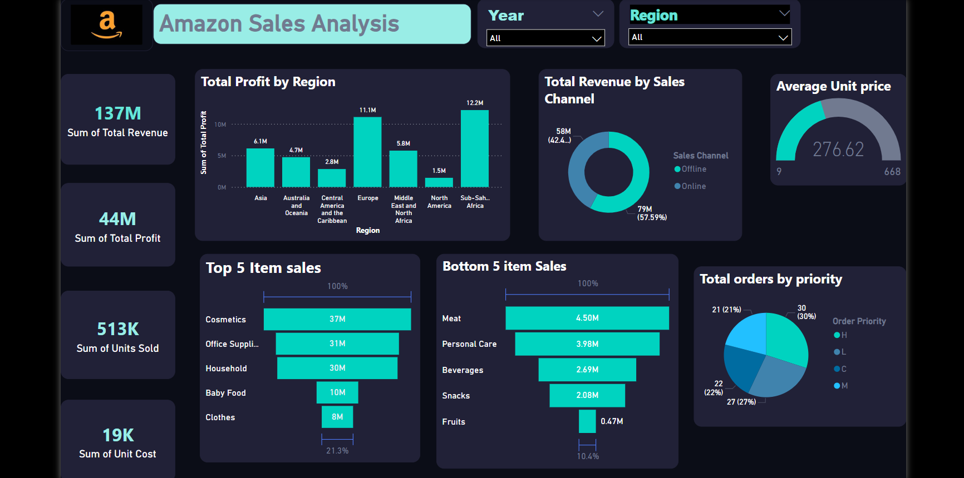

Slide 5
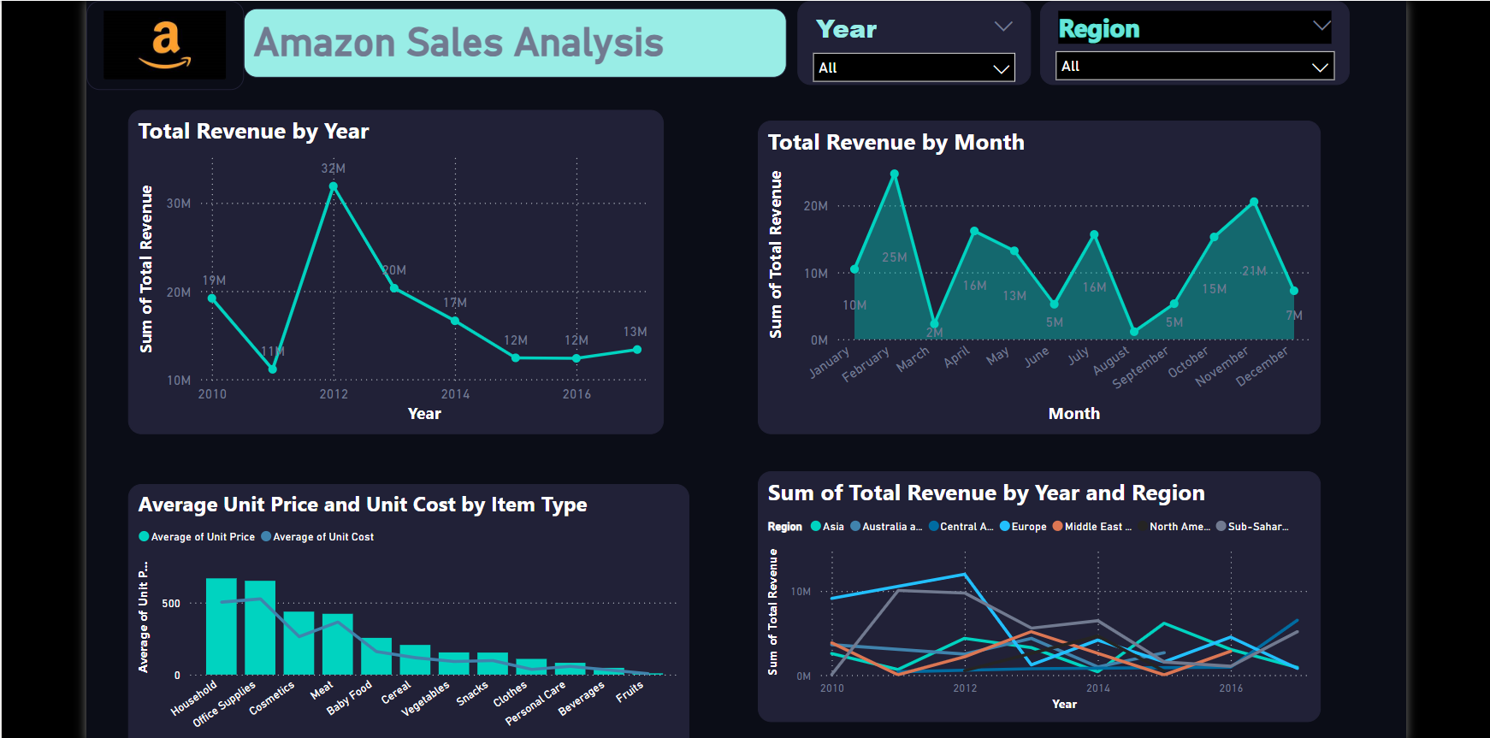

Slide 6

Insights
KPIs
Regional Performance:
Total Revenue is 137 M
Total Profit is 44M
It indicate healthy profit margin of around 32% overall.
Sum of Units Sold is 513K
Sum of Units cost is 19k
Sub-Saharan Africa has the highest total profit (12.2M), followed by Europe (11.1M).
North America is lagging with the lowest profit (1.5M), which suggests a need for strategy optimization in that region.

Slide 7
Insights
Sales Channel Contribution
57.59% of total revenue is generated offline, signaling an opportunity for growth in online channels.
Order Prioritization
A Significant portion of orders (30%) falls under high priority, while medium priority orders account for 21%
Top and Bottom Products
Top sales come from cosmetics (37M), office supplies (31M), and household items (30M)
while the bottom five categories include fruits (0.47M), snacks (2.08M), and beverages (2.69M).

Slide 8
Insights
Revenue Trend
Item Pricing and Cost Efficiency
Monthly Trend
There was a peak in total revenue in 2012 (32M), followed by a steady decline until 2016 (12M).
It would be worth investigating the causes of this drop and addressing market challenges or external factors during this period.
Household items and office supplies have the highest average unit price, but these categories also have relatively high unit costs.
In contrast, beverages and fruits have low unit prices and costs, but their contribution to total revenue is minimal.
Monthly revenue shows spikes in January followed by a decline towards the end of the year.
Notably, revenue jumped from $10 million in January to $25 million in February.

Slide 9






Improvement
Review pricing models
For categories like household items , personal care which have high average unit costs and prices, look for cost cutting opportunities.
Consider renegotiating supplier contracts or moving production to more cost efficient location to increase profit margins without raising prices.
Focus on North American Market
Research local preferences and trends to tailor product offerings that meet the specific needs of North American customers.
Consider adding more items across various categories that are popular or trending in North America
Enhance Low-Performing Categories
For underperforming items, we can pair them with best selling items or create targeted promotions.
Since Categories like fruits, snack, beverages are low performing category, we can offer premium or organic options to grab the attention of health conscious customer.
Seasonal and Targeted Promotions:
The revenue declined from April to August. we can plan specific campaign for these month like back-to-school promotions or summer sales for cosmetic and personal care items.
Boost Online Sales
We can encourage online purchases by offering them discount or by running sales.
We can also introduce exclusive brands will differentiate our online platform and attract shoppers seeking unique products
Holiday Campaigns :
Despite a decline in the later months (December), sales usually peak around holidays.
Promote holiday-exclusive bundles, free shipping offers, or early Black Friday deals to capitalize on the holiday shopping surge.

Slide 10

By focusing on regional growth, pricing strategies, and operational efficiency, Amazon can increase profitability and maintain a competitive edge.

